Slide 1
JAVA I/O STREAMS
NETWORK PROGRAMMING

Slide 2
PART 1 – INPUT/OUTPUT STREAMS
Stream concepts
Input Streams
Output Streams
Reader
Writer
Object Serialization
Object Input Stream
Object Output Stream

Slide 3
Stream concepts
File
information
Program
Memory
Network
Program
Data exchange
Data exchange type: Character, Object, voice, picture, audio, video...

Slide 4
Stream
Stream:
  dòng thông tin giữa 2 tác nhân (mức cao)
  một dãy tuần tự các byte (mức thấp)
Một stream được gắn với một nguồn (source), hay một đích (destination)
Stream operations:
  open stream
  close stream
  read
  write
  seek
Input stream: support reading functions
Output stream: support writing functions
Filter stream: buffer

Slide 5


Input & Output Stream
Hình 1: Chương trình xử lý dữ liệu từ 1 input stream
Hình 2: Chương trình ghi dữ liệu ra output stream

Slide 6
Trình tự đọc/ ghi dòng
open input stream
while (more information){
read information
process information
}
close input stream
Đọc thông tin
từ input stream
open output stream
while (more information){
get information from ...
write information
}
close output stream
Ghi thông tin
vào output stream

Slide 7
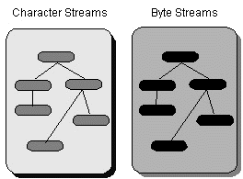
Các loại stream trong package java.io
các lớp trong gói java.io được thiết kế gồm 2 nhóm chính:
  Nhóm input/output stream, hay nhóm hướng byte
  Nhóm reader/writer, hay nhóm hướng ký tự (unicode)

Slide 8
Nhóm input/output stream
được gọi là nhóm hướng byte, vì thao tác đọc/ghi áp dụng cho 1 hoặc nhiều byte
chỉ giới hạn xử lý các byte 8 bits ISO-Latin-1.
rất thích hợp khi cần xử lý dữ liệu nhị phân như ảnh, âm thanh, binary files...
Các input stream được mở rộng từ lớp InputStream (Abstract class)
Các output stream được mở rộng từ lớp OutputStream (Abstract class)

Slide 9
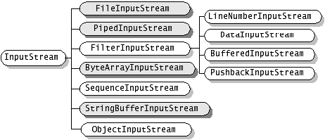
Nhóm input stream

Slide 10
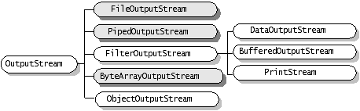
Nhóm output stream

Slide 11

Nhóm reader/writer
được gọi là nhóm hướng ký tự, vì thao tác đọc/ghi áp dụng cho 1 hoặc nhiều ký tự Unicode (1 character = 2bytes)

Slide 12
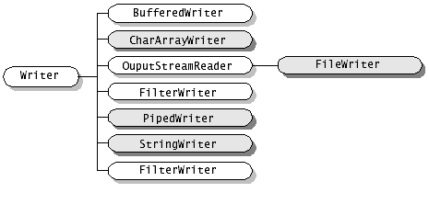
Nhóm Writer

Slide 13
Các loại các stream (tt)
java IO cũng cung cấp cách thức kết gắn stream với các loại tác nhân khác như bộ nhớ, file ...
Các lớp InputStreamReader và OutputStreamWriter cung cấp sự chuyển đổi giữa stream và reader/writer
Xem bảng phân loại tóm tắt để biết thêm chi tiết

Slide 14
Tổng quát về các Streams
I/O | Streams | Mô tả khái quát
Memory | CharArrayReader CharArrayWriter ByteArrayInput- Stream ByteArrayOutput-Stream | Đọc/ghi từ/vào bộ nhớ. Tạo stream từ một mảng, tiếp theo dùng các phương thức đọc/ghi để đọc/ghi từ/vào mảng. Tác vụ đọc sẽ lấy dữ liệu từ mảng Tác vụ ghi sẽ ghi ra mảng
 | StringReader StringWriter StringBuffer- InputStream | StringReader để đọc các ký tự từ một String trong bộ nhớ. StringWriter để ghi vào String. StringBufferInputStream tương tự như StringReader. Sự khác biệt chỉ là StringBufferInputStream đọc các bytes từ một đối tượng StringBuffer

Slide 15
Tổng quát về các Streams
Pipe | PipedReader PipedWriter PipedInputStream PipedOutputStream | Hiện thực các thành phần input và output của một pipe. Pipes được dùng như một kênh truyền, nối output của một thread vào input của một thread khác.
File | FileReader FileWriter FileInputStream FileOutputStream | Được gọi là các file streams. File streams dùng để đọc/ghi từ/vào file trên file system.
Nối | SequenceInput- Stream (concatenation) | Nối nhiều input streams thành một input stream.

Slide 16
Tổng quát về các Streams
Object Serial- ization | ObjectInputStream ObjectOutputStream | Dùng khi cần lưu trữ, khôi phục, hoặc truyền toàn bộ đối tượng.
Chuyển đổi dạng dữ liệu (Data Conver-sion) | DataInputStream DataOutputStream | Thuận tiện khi cần đọc/ghi các kiểu dữ liệu cơ bản (primitive data types) như int, double, ...
Counting | LineNumberReader LineNumberInput- Stream | Theo dõi số hàng trong khi đọc

Slide 17
Tổng quát về các Streams
Printing | PrintWriter PrintStream | Rất thuận tiện khi cần kết xuất, dễ đọc với người. System.out là một đối tượng thuộc lớp PrintStream.
Đệm (Buffer-ing) | BufferedReader BufferedWriter bufferedInput-Stream BufferedOutput-Stream | Đệm dữ liệu trong các thao tác đọc/ghi. Đệm dữ liệu cải thiện tốc độ đọc ghi vì giảm số lần truy xuất thiết bị.
Lọc dữ liệu (Filtering) | FilterReader FilterWriter FilterInputStream FilterOutputStream | Các lớp abstract này định nghĩa các giao tiếp cho các filter streams lọc dữ liệu trong khi đọc/ghi.

Slide 18
Tổng quát về các Streams
Chuyển đổi byte ⬄ ký tự (Converting between Bytes and Characters) | InputStreamReader OutputStreamWriter | Cặp reader/writer này là cầu nối giữa các byte streams và character streams. Một InputStreamReader đọc các bytes từ một InputStream và chuyển các bytes đó thành các ký tự. Một OutputStreamWriter chuyển các ký tự sang các bytes, và ghi các bytes đó vào một OutputStream. Quá trình chuyển đổi sẽ sử dụng bộ mã mặc định nếu không được chỉ định rõ. Gọi System.getProperty("file.encoding") để lấy về tên bộ mã mặc định.

Slide 19
Các lớp IO
InputStream, OutputStream, Reader và Writer là các lớp abstract:
  Các lớp input stream được mở rộng từ lớp InputStream
  Các lớp reader được mở rộng từ lớp Reader
  Các lớp output stream được mở rộng từ lớp OutputStream
  Các lớp writer được mở rộng từ lớp Writer
2 lớp InputStream và Reader cung cấp những phương thức read tương đối giống nhau.
2 lớp OutputStream và Writer cung cấp những phương thức write tương đối giống nhau.

Slide 20
InputSream
Low-Level Input Stream Purpose of Stream
ByteArrayInputStream Reads bytes of data from an memory array
FileInputStream Reads bytes of data from a file on the local file system
PipedInputStream Reads bytes of data from a thread pipe
StringBufferInputStream Reads bytes of data from a string
SequenceInputStream Reads bytes of data from two or more low-level streams, switching from one stream to the next when the end of the stream is reached
System.in Reads bytes of data from the user console

Slide 21
The java.io.InputStream Class
int available() throws java.io.IOException— returns the number of bytes currently available for reading.
void close() throws java.io.IOException— closes the input stream and frees any resources (such as file handles or file locks) associated with the input stream.
int read() throws java.io.IOException— returns the next byte of data from the stream. When the end of the stream is reached, a value of –1 is returned.
int read(byte[] byteArray) throws java.io.IOException— reads a sequence of bytes and places them in the specified byte array. This method returns the number of bytes successfully read, or –1 if the end of the stream has been reached.
int read(byte[] byteArray, int offset, int length) throws java.io.IOException, java.lang.IndexOutOfBoundsException— reads a sequence of bytes, placing them in the specified array at the specified offset, and for the specified length, if possible.

Slide 22
The java.io.InputStream Class
long skip(long amount) throws java.io.IOException— reads, but ignores, the specified amount of bytes. These bytes are discarded, and the position of the input stream is updated. The skip method returns the number of bytes skipped over, which may be less than the requested amount.
The following code fragment reads 10 bytes from the InputStream in and stores them in the byte array input. However, if end of stream is detected, the loop is terminated early:
  byte[] input = new byte[10];
  for (int i = 0; i < input.length; i++) {
  int b = in.read( );
  if (b == -1) break;
  input[i] = (byte) b;
  }

Slide 23
The java.io.InputStream Class
For example, you may try to read 1 024 bytes from a network connection, when only 512 have actually arrived from the server. The rest are still in transit. They'll arrive eventually, but they aren't available now.
byte[] input = new byte[1024];
  int bytesRead = in.read(input);
It attempts to read 1 024 bytes from the InputStream in into the array input. However, if only 512 bytes are available, then bytesRead will be set to 512. To guarantee that all the bytes you want are actually read, you must place the read in a loop that reads repeatedly until the array is filled.
  int bytesRead = 0;
  int bytesToRead = 1024;
  byte[] input = new byte[bytesToRead];
  while (bytesRead < bytesToRead) {
  bytesRead += in.read(input, bytesRead, bytesToRead - bytesRead);
  }

Slide 24
The java.io.File Class
An abstract representation of file and directory pathnames.
For UNIX platforms, the prefix of an absolute pathname is always "/". Relative pathnames have no prefix.
For Microsoft Windows platforms, the prefix of a pathname that contains a drive specifier consists of the drive letter followed by ":" and possibly followed by "\\" if the pathname is absolute (D:\\myfolder\\t.txt). A relative pathname that does not specify a drive has no prefix.
public File(File parent, String child)
  Creates a new File instance from a parent abstract pathname and a child pathname string.
public File(String parent, String child)
  Creates a new File instance from a parent pathname string and a child pathname string.

Slide 25
The java.io.File Class
public File(String pathname)
  Creates a new File instance by converting the given pathname string into an abstract pathname. If the given string is the empty string, then the result is the empty abstract pathname.
public String getPath()
  Converts this abstract pathname into a pathname string.
public boolean isAbsolute()
  Tests whether this abstract pathname is absolute.
public String getAbsolutePath()
  Returns the absolute pathname string of this abstract pathname.
public boolean canRead()
  Tests whether the application can read the file denoted by this abstract pathname.

Slide 26
The java.io.File Class
public boolean canWrite()
  Tests whether the application can modify the file denoted by this abstract pathname
public boolean exists()
  Tests whether the file or directory denoted by this abstract pathname exists.
public boolean isDirectory()
  Tests whether the file denoted by this abstract pathname is a directory.
public boolean isFile()
  Tests whether the file denoted by this abstract pathname is a normal file.
public boolean isHidden()
  Tests whether the file named by this abstract pathname is a hidden file.

Slide 27
The java.io.File Class
public long length()
  Returns the length (the zise in Kbyte) of the file denoted by this abstract pathname. The return value is unspecified if this pathname denotes a directory.
public boolean delete()
  Deletes the file or directory denoted by this abstract pathname. If this pathname denotes a directory, then the directory must be empty in order to be deleted.
public String[] list()
  Returns an array of strings naming the files and directories in the directory denoted by this abstract pathname.
public String[] list(FilenameFilter filter)
  Returns an array of strings naming the files and directories in the directory denoted by this abstract pathname that satisfy the specified filter. The behavior of this method is the same as that of the list() method, except that the strings in the returned array must satisfy the filter. If the given filter is null then all names are accepted.

Slide 28
The java.io.File Class
public File[] listFiles()
  Returns an array of abstract pathnames denoting the files in the directory denoted by this abstract pathname.
public File[] listFiles(FilenameFilter filter)
  Returns an array of abstract pathnames denoting the files and directories in the directory denoted by this abstract pathname that satisfy the specified filter.
public boolean mkdir()
  Creates the directory named by this abstract pathname.
public boolean mkdirs()
  Creates the directory named by this abstract pathname, including any necessary but nonexistent parent directories. Note that if this operation fails it may have succeeded in creating some of the necessary parent directories.

Slide 29
The java.io.File Class
//List of all files in D: with extention tgz
import java.io.*;
import java.util.*;
public class DLister {
  public static void main(String[] args) {
  File path = new File("D:\\");
  String[] list;
  list = path.list(new DirFilter(".tgz"));
  for(int i = 0; i < list.length; i++)
  System.out.println(list[i]);
  } }
class DirFilter implements FilenameFilter {
String afn;
DirFilter(String afn) { this.afn = afn; }
public boolean accept(File dir, String name) {
String f = new File(name).getName();
return f.indexOf(afn) != -1;
} }

Slide 30
Exercise
public boolean deleteDir(String path)
public boolean find(String path, String filePattern)
public boolean find(String path, String pattern)

Slide 31
The java.io.FileInputStream Class
A FileInputStream obtains input bytes from a file in a file system. What files are available depends on the host environment.
FileInputStream is meant for reading streams of raw bytes such as image data. For reading streams of characters, consider using FileReader.
public FileInputStream(File file) throws FileNotFoundException
  Creates a FileInputStream by opening a connection to an actual file, the file named by the File object file in the file system. A new FileDescriptor object is created to represent this file connection.
public FileInputStream(String name) throws FileNotFoundException
  Creates a FileInputStream by opening a connection to an actual file, the file named by the path name name in the file system.

Slide 32
The java.io.FileInputStream Class
public int read() throws IOException
  Reads a byte of data from this input stream. This method blocks if no input is yet available.
  Returns: the next byte of data, or -1 if the end of the file is reached.
public int read(byte[] b) throws IOException
public int read(byte[] b, int off, int len)
  Reads up to b.length bytes of data from this input stream into an array of bytes. This method blocks until some input is available.
  Parameters:
    b - the buffer into which the data is read.
    off - the start offset of the data.
    len - the maximum number of bytes read.
  Returns: the total number of bytes read into the buffer, or -1 if there is no more data because the end of the file has been reached.

Slide 33
The java.io.FileInputStream Class
public long skip(long n) throws IOException
  Skips over and discards n bytes of data from the input stream.
  Parameters: n - the number of bytes to be skipped.
  Returns: the actual number of bytes skipped.
  Throws: IOException - if n is negative, or if an I/O error occurs.
public int available() throws IOException
  Returns the number of bytes that can be read from this file input stream without blocking.
public void close() throws IOException
  Closes this file input stream and releases any system resources associated with the stream.

Slide 34
FileInputStream Demo
Below we examine a practical application of using a low-level input stream to display the contents of a file. A byte at a time is read from the file and displayed to the screen.
// Create an input stream, reading from the specified file
InputStream fileInput = new FileInputStream (fName);
// Read the first byte of data
int data = fileInput.read();
// Repeat : until end of file (EOF) reached
while (data != -1){
// Send byte to standard output
System.out.write ( data );
// Read next byte
data = fileInput.read();
}

Slide 35
FileInputStreamDemo
import java.io.*;
public class FileInputStreamDemo{
public static void main(String args[]){
if (args.length != 1){
System.err.println ("Syntax - FileInputStreamDemo file");
return;
}
try{
InputStream fileInput = new FileInputStream( args[0] );
int data = fileInput.read();
while (data != -1){
System.out.write ( data );
data = fileInput.read();
}
// Close the file
fileInput.close();
}
catch (IOException ioe){
System.err.println ("I/O error - " + ioe);
}}}

Slide 36
Ouput Streams
Low-Level Output Stream Purpose of Stream
ByteArrayOutputStream Writes bytes of data to an array of bytes.
FileOutputStream Writes bytes of data to a local file.
PipedOutputStream Writes bytes of data to a communications pipe, which will be connected to a PipedInputStream.
StringBufferOutputStream Writes bytes to a string buffer (a substitute data structure for the fixed-length string).
System.err Writes bytes of data to the error stream of the user console, also known as standard error. In addition, this stream is cast to a PrintStream.
System.out Writes bytes of data to the user console, also known as standard output. In addition, this stream is cast to a PrintStream.

Slide 37
The java.io.OutputStream Class
void close() throws java.io.IOException— closes the output stream, notifying the other side that the stream has ended. Pending data that has not yet been sent will be sent, but no more data will be delivered.
void flush() throws java.io.IOException— performs a "flush" of any unsent data and sends it to the recipient of the output stream. To improve performance, streams will often be buffered, so data remains unsent. This is useful at times, but obstructive at others. The method is particularly important for OutputStream subclasses that represent network operations, as flushing should always occur after a request or response is sent so that the remote side isn't left waiting for data.

Slide 38
The java.io.OutputStream Class
void write(int byte) throws java.io.IOException writes the specified byte. This is an abstract method, overridden by OutputStream subclasses.
void write(byte[] byteArray) throws java.io.IOException writes the contents of the byte array to the output stream. The entire contents of the array (barring any error) will be written.
void write(byte[] byteArray, int offset, int length) throws java.io.IOException writes the contents of a subset of the byte array to the output stream. This method allows developers to specify just how much of an array is sent, and which part, as opposed to the OutputStream.write(byte[] byteArray) method, which sends the entire contents of an array.

Slide 39
Java.io.FileOutputStream
public FileOutputStream(String name) throws FileNotFoundException
  Creates an output file stream to write to the file with the specified name.
  Throws: FileNotFoundException - if the file exists but is a directory rather than a regular file, does not exist but cannot be created, or cannot be opened for any other reason
public FileOutputStream(String name, boolean append) throws FileNotFoundException
  Creates an output file stream to write to the file with the specified name. If the second argument is true, then bytes will be written to the end of the file rather than the beginning.
  If the file exists but is a directory rather than a regular file, does not exist but cannot be created, or cannot be opened for any other reason then a FileNotFoundException is thrown.

Slide 40
Java.io.FileOutputStream
public FileOutputStream(File file) throws FileNotFoundException
  Creates a file output stream to write to the file represented by the specified File object
public FileOutputStream(File file, boolean append) throws FileNotFoundException
public void write(int b) throws IOException
  Writes the specified byte to this file output stream. Implements the write method of OutputStream.
public void write(byte[] b) throws IOException
  Writes b.length bytes from the specified byte array to this file output stream.
public void write(byte[] b, int off, int len) throws IOException
  Writes len bytes from the specified byte array starting at offset off to this file output stream.
public void close() throws IOException
  Closes this file output stream and releases any system resources associated with this stream. This file output stream may no longer be used for writing bytes.

Slide 41
FileOutputStream Demo (FileCopy)
The program copies a file by reading the contents of the file and writing it, one byte at a time, to a new file.
To open a file for writing, a FileOutputStream is used. This class will create a file, if one does not already exist, or override the contents of the file (unless opened in append mode).
// Output file for output
OutputStream output = new FileOutputStream(destination);
Once opened, it can be written to by invoking the OutputStream.write() method. This method is called repeatedly by the application, to write the contents of a file that it is reading.
while ( data != -1){
// Write byte of data to our file
output.write (data);
// Read next byte
data=input.read();
}

Slide 42
FileOutputStream Demo (FileCopy)
import java.io.*;
public class FileOutputStreamDemo{
public static void main(String args[]){
// Two parameters are required, the source and destination
if (args.length != 2){
System.err.println("Syntax - FileOutputStreamDemo src dest");
return;
}
String source = args[0];
String destination = args[1];
try{
// Open source file for input
InputStream input = new FileInputStream( source );
System.out.println ("Opened " +source + " for reading.");
// Output file for output
OutputStream output = new FileOutputStream(destination);
System.out.println ("Opened " +destination + " for writing.");

Slide 43
FileOutputStream Demo (FileCopy)
int data = input.read();
while ( data != -1){
// Write byte of data to our file
output.write (data);
// Read next byte
data=input.read();
}
// Close both streams
input.close();
output.close();
System.out.println ("I/O streams closed");
}
catch (IOException ioe){
System.err.println ("I/O error - " + ioe);
}}}

Slide 44
Filter Streams
Filter streams add additional functionality to an existing stream, by processing data in some form (such as buffering for performance) or offering additional methods that allow data to be accessed in a different manner (for example, reading a line of text rather than a sequence of bytes).
Filters make life easier for programmers, as they can work with familiar constructs such as strings, lines of text, and numbers, rather than individual bytes.
Filter streams can be connected to any other stream, to a low-level stream or even another filter stream. Filter streams are extended from the java.io.FilterInputStream and java.io.FilterOutputStream classes.

Slide 45
Filter Streams
For example, suppose you wanted to connect a PrintStream (used to print text to an OutputStream subclass) to a stream that wrote to a file. The following code may be used to connect the filter stream and write a message using the new filter.
FileOutputStream fout = new FileOutputStream ( somefile );
PrintStream pout = new PrintStream (fout);
pout.println ("hello world");
This process is fairly simple as long as the programmer remembers two things:
  Read and write operations must take place on the new filter stream.
  Read and write operations on the underlying stream can still take place, but not at the same time as an operation on the filter stream.

Slide 46
Filter Input Streams
Filter Input Stream Purpose of Stream
BufferedInputStream Buffers access to data, to improve efficiency.
DataInputStream Reads primitive data types, such as an int, a float, a double, or even a line of text, from an input stream.
PushBackInputStream Allows a byte of data to be pushed into the head of the stream.

Slide 47
BufferedInputStream
BufferedInputStream (InputStream input) creates a buffered stream that will read from the specified InputStream object.
BufferedInputStream (InputStream input, int bufferSize) throws java.lang.IllegalArgumentException— creates a buffered stream, of the specified size, which reads from the InputStream object passed as a parameter.
BufferedInputStream does not declare any new methods of its own. It only overrides methods from InputStream.
Chaining Filters Together
DataOutputStream dout = new DataOutputStream(
new BufferedOutputStream(
new FileOutputStream("data.txt")));
DataInputStream din = new DataInputStream(
new BufferedInputStream(
new FileInputStream("data.txt")));

Slide 48
FileCopy using BufferedInputStream
import java.io.*;
public class BufferCopyFile{
public static void copy(String sfile, String destfile) throws IOException{
int bufferSize = 10240;
BufferedInputStream fis = new BufferedInputStream(new FileInputStream(sfile),bufferSize);
BufferedOutputStream fos = new BufferedOutputStream(new FileOutputStream(destfile),bufferSize);
int c;
long beginTime = System.currentTimeMillis();
while((c=fis.read())>-1) fos.write(c);
long endTime = System.currentTimeMillis();
System.out.println("Copy time: "+(endTime-beginTime)+ "ms");
fis.close();
fos.close();
}

Slide 49
A Speed of new FileCopy
Example runs of the following BufferCopyFile, with text files of various sizes, shows gains of ~3x. (In Java Platform Performance by Wilson and Kesselman, an example using a 370K JPEG file has a gain in execution speed of 83x!)
Size - 624 bytes :
With buffering: 10 ms
Without buffering: 30 ms
Size - 10,610 bytes :
With buffering: 30 ms
Without buffering: 80 ms
Size - 742,702 bytes :
With buffering: 180 ms
Without buffering: 741 ms

Slide 50
DataInputStream Class
The DataInputStream and DataOutputStream classes provide methods for reading and writing Java's primitive data types and strings in a binary format. The binary formats used are primarily intended for exchanging data between two different Java programs whether through a network connection, a data file, a pipe, or some other intermediary. What a data output stream writes, a data input stream can read.
Constructors DataInputStream (InputStream in) creates a data input stream, reading from the specified input stream.

Slide 51
DataInputStream Class
public final int read(byte[] b) throws IOException
  Reads some number of bytes from the contained input stream and stores them into the buffer array b. This method blocks until input data is available, end of file is detected, or an exception is thrown.
public final int read(byte[] b, int off, int len) throws IOException
  Reads up to len bytes of data from the contained input stream into an array of bytes. This method blocks until input data is available, end of file is detected, or an exception is thrown.
public final int skipBytes(int n)
public final boolean readBoolean()
public final byte readByte() : signed 8-bit byte
public final int readUnsignedByte() : an unsigned 8-bit number

Slide 52
DataInputStream Class
public final short readShort() : a signed 16-bit number
public final int readUnsignedShort() : an unsigned 16-bit integer
public final char readChar() : 2 bytes of this input stream as a Unicode character
public final int readInt() : 4 bytes of this input stream, interpreted as an int
public final long readLong() : eight bytes of this input stream, interpreted as a long
public final float readFloat() : 4 bytes of this input stream, interpreted as a float.
public final double readDouble() : 8 bytes of this input stream, interpreted as a double

Slide 53
PrintStream Class
The PrintStream class is the first filter output stream most programmers encounter because System.out is a PrintStream. However, other output streams can also be chained to print streams, using these two constructors:
public PrintStream(OutputStream out)
public PrintStream(OutputStream out, boolean autoFlush)
By default, print streams should be explicitly flushed. However, if the autoFlush argument is true, then the stream will be flushed every time a byte array or linefeed is written or a println( ) method is invoked.

Slide 54
PrintStream Class
void print(boolean value)— prints a boolean value.
void print(char character)— prints a character value.
void print(char[] charArray)— prints an array of characters.
void print(double doubleValue)— prints a double value.
void print(float floatValue)— prints a float value.
void print(int intValue)— prints an int value.
void print(long longValue)— prints a long value.
void print(Object obj)— prints the value of the specified object's toString() method.
void print(String string)— prints a string's contents.
void println()— sends a line separator (such as '\n'). This value is system dependent and determined by the value of the system property "line.separator."

Slide 55
Random Access File Stream
Lớp RandomAccessFile:
  Cung cấp cách thức đọc/ghi dữ liệu từ/ra file
  cung cấp thêm thao tác seek → vị trí đọc/ghi là bất kỳ (random access)
một random access file chứa 1 file pointer chỉ đến vị trí sẽ được truy xuất:
  phương thức seek di chuyển file pointer đến vị trí bất kỳ
  phương thức getFilePointer trả về vị trí hiện tại của file pointer

Slide 56
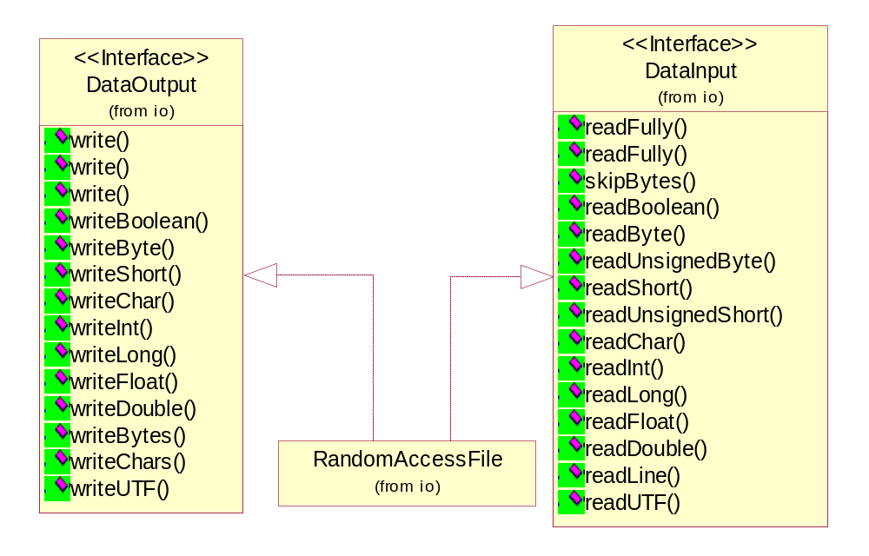
Random Access File Stream

Slide 57
Java.io.RandomAccessFile
A random access file behaves like a large array of bytes stored in the file system. There is a kind of cursor, or index into the implied array, called the file pointer; input operations read bytes starting at the file pointer and advance the file pointer past the bytes read
The file pointer can be read by the getFilePointer method and set by the seek method
public RandomAccessFile(String name, String mode)
public RandomAccessFile(File file, String mode)
  Creates a random access file stream to read from, and optionally to write to, a file with the specified name.
  "r“ Open for reading only.
  "rw“ Open for reading and writing. If the file does not already exist then an attempt will be made to create it.

Slide 58
Java.io.RandomAccessFile
public int read() throws IOException
  Reads a byte of data from this file. The byte is returned as an integer in the range 0 to 255 (0x00-0x0ff). This method blocks if no input is yet available.
public int read(byte[] b, int off, int len) throws IOException
  Reads up to len bytes of data from this file into an array of bytes. This method blocks until at least one byte of input is available.
public int read(byte[] b) throws IOException
  Reads up to b.length bytes of data from this file into an array of bytes. This method blocks until at least one byte of input is available.
public long getFilePointer() throws IOException
  Returns the current offset in this file.

Slide 59
Java.io.RandomAccessFile
public void write(int b) throws IOException
  Writes the specified byte to this file. The write starts at the current file pointer.
public void write(byte[] b) throws IOException
  Writes b.length bytes from the specified byte array to this file, starting at the current file pointer.
public void write(byte[] b, int off, int len) throws …
  Writes len bytes from the specified byte array starting at offset off to this file
public void seek(long pos) throws IOException
  Sets the file-pointer offset, measured from the beginning of this file, at which the next read or write occurs. The offset may be set beyond the end of the file. Setting the offset beyond the end of the file does not change the file length. The file length will change only by writing after the offset has been set beyond the end of the file.

Slide 60
Java.io.RandomAccessFile
public long length() throws IOException
  Returns the length of this file.
public void setLength(long newLength) throws ….
  Sets the length of this file. If the present length of the file is greater than the newLength argument then the file will be truncated. In this case, if the file offset as returned by the getFilePointer method is greater than newLength then after this method returns the offset will be equal to newLength.
  If the present length of the file as returned by the length method is smaller than the newLength argument then the file will be extended. In this case, the contents of the extended portion of the file are not defined.
public void close() throws IOException
  Closes this random access file stream and releases any system resources associated with the stream

Slide 61
Java.io.RandomAccessFile
public final boolean readBoolean()
public final byte readByte()
public final int readUnsignedByte()
public final short readShort()
public final int readUnsignedShort()
public final char readChar()
public final int readInt()
public final long readLong()
public final float readFloat()
public final double readDouble()
public final String readLine()
public final void writeBoolean(boolean v)
public final void writeByte(int v)
public final void writeShort(int v)

Slide 62
Java.io.RandomAccessFile
public final void writeChar(int v)
public final void writeInt(int v)
public final void writeLong(long v)
public final void writeFloat(float v)
public final void writeDouble(double v)
public final void writeBytes(String s) throws IOException
  Writes the string to the file as a sequence of bytes. Each character in the string is written out, in sequence, by discarding its high eight bits. The write starts at the current position of the file pointer.
public final void writeChars(String s) throws IOException
  Writes a string to the file as a sequence of characters. Each character is written to the data output stream as if by the writeChar method. The write starts at the current position of the file pointer.

Slide 63
New I/O
The Java “new” I/O library, introduced in JDK 1.4 in the java.nio.* packages, has one goal: speed.
The speed comes by using structures which are closer to the operating system’s way of performing I/O: channels and buffers.
The NIO APIs include the following features:
  Buffers for data of primitive types
  Character-set encoders and decoders
  Channels, a new primitive I/O abstraction
  A file interface that supports locks and memory mapping
  A multiplexed, non-blocking I/O facility for writing scalable servers

Slide 64
java.nio.ByteBuffer
public static ByteBuffer allocate(int capacity)
  Allocates a new byte buffer. The new buffer's position will be zero, its limit will be its capacity
public abstract byte get()
  Relative get method. Reads the byte at this buffer's current position, and then increments the position.
public abstract ByteBuffer put(byte b)
  Relative put method (optional operation). Writes the given byte into this buffer at the current position, and then increments the position.
public abstract byte get(int index)
  Absolute get method. Reads the byte at the given index.
public abstract ByteBuffer put(int index, byte b)
  Absolute put method (optional operation). Writes the given byte into this buffer at the given index.
public ByteBuffer get(byte[] dst, int offset, int length)
  Relative bulk get method. Otherwise, this method copies length bytes from this buffer into the given array, starting at the current position of this buffer and at the given offset in the array. The position of this buffer is then incremented by length.

Slide 65
java.nio.ByteBuffer
public ByteBuffer get(byte[] dst)
  Relative bulk get method. This method transfers bytes from this buffer into the given destination array.
public ByteBuffer put(ByteBuffer src)
  Relative bulk put method (optional operation). This method transfers the bytes remaining in the given source buffer into this buffer. If there are more bytes remaining in the source buffer than in this buffer, that is, if src.remaining() > remaining(), then no bytes are transferred and a BufferOverflowException is thrown.
public ByteBuffer put(byte[] src, int offset, int length)
  Relative bulk put method (optional operation). this method copies length bytes from the given array into this buffer, starting at the given offset in the array and at the current position of this buffer. The position of this buffer is then incremented by length.
public final ByteBuffer put(byte[] src)
  Relative bulk put method (optional operation). This method transfers the entire content of the given source byte array into this buffer.
public final byte[] array()
  Returns the byte array that backs this buffer (optional operation).

Slide 66
java.nio.ByteBuffer
public abstract char getChar()
  Relative get method for reading a char value. Reads the next two bytes at this buffer's current position, composing them into a char value according to the current byte order, and then increments the position by two.
public abstract ByteBuffer putChar(char value)
  Relative put method for writing a char value (optional operation). Writes two bytes containing the given char value, in the current byte order, into this buffer at the current position, and then increments the position by two.
public abstract char getChar(int index)
  Absolute get method for reading a char value. Reads two bytes at the given index, composing them into a char value according to the current byte order.
public abstract ByteBuffer putChar(int index, char value)
  Absolute put method for writing a char value (optional operation). Writes two bytes containing the given char value, in the current byte order, into this buffer at the given index.
public abstract CharBuffer asCharBuffer()
  Creates a view of this byte buffer as a char buffer.

Slide 67
java.nio.ByteBuffer
public abstract short getShort()
public abstract ByteBuffer putShort(short value)
public abstract short getShort(int index)
public abstract ByteBuffer putShort(int index, short value)
public abstract int getInt()
public abstract ByteBuffer putInt(int value)
public abstract int getInt(int index)
public abstract ByteBuffer putInt(int index, int value)
public abstract IntBuffer asIntBuffer()
Long, Float, Double

Slide 68
java.nio.Buffer
A container for data of a specific primitive type:
A buffer is a linear, finite sequence of elements of a specific primitive type. Aside from its content, the essential properties of a buffer are its capacity, limit, and position:
A buffer's capacity is the number of elements it contains. The capacity of a buffer is never negative and never changes.
A buffer's limit is the index of the first element that should not be read or written. A buffer's limit is never negative and is never greater than its capacity.
A buffer's position is the index of the next element to be read or written. A buffer's position is never negative and is never greater than its limit.

Slide 69
java.nio.Buffer
public final int capacity()
  Returns this buffer's capacity.
public final int position()
  Returns this buffer's position.
public final Buffer position(int newPosition)
  Sets this buffer's position. If the mark is defined and larger than the new position then it is discarded.
public final int limit()
  Returns this buffer's limit.
public final Buffer limit(int newLimit)
  Sets this buffer's limit. If the position is larger than the new limit then it is set to the new limit. If the mark is defined and larger than the new limit then it is discarded.

Slide 70
java.nio.Buffer
public final Buffer flip()
  Flips this buffer. The limit is set to the current position and then the position is set to zero. If the mark is defined then it is discarded. After a sequence of channel-read or put operations, invoke this method to prepare for a sequence of channel-write or relative get operations. For example:
  buf.put(magic); // Prepend header
  in.read(buf); // Read data into rest of buffer
  buf.flip(); // Flip buffer
  out.write(buf); // Write header + data to channel
public final Buffer rewind()
  Rewinds this buffer. The position is set to zero and the mark is discarded. Invoke this method before a sequence of channel-write or get operations, assuming that the limit has already been set appropriately. For example:
  out.write(buf); // Write remaining data
  buf.rewind(); // Rewind buffer
  buf.get(array); // Copy data into array

Slide 71
java.nio.Buffer
public final Buffer clear()
  Clears this buffer. The position is set to zero, the limit is set to the capacity, and the mark is discarded. Invoke this method before using a sequence of channel-read or put operations to fill this buffer. For example:
  buf.clear(); // Prepare buffer for reading
  in.read(buf); // Read data
public final int remaining()
  Returns the number of elements between the current position and the limit.
public final boolean hasRemaining()
  Tells whether there are any elements between the current position and the limit.

Slide 72
java.nio.channels.FileChannel
This class does not define methods for opening existing files or for creating new ones; such methods may be added in a future release. In this release a file channel can be obtained from an existing FileInputStream, FileOutputStream, or RandomAccessFile object by invoking that object's getChannel method, which returns a file channel that is connected to the same underlying file.
public abstract int read(ByteBuffer dst)
public abstract long read(ByteBuffer[] dsts, int offset, int length)
public abstract int write(ByteBuffer src)
public abstract long write(ByteBuffer[] srcs, int offset, int length)
public abstract long position()
public abstract FileChannel position(long newPosition)

Slide 73
java.nio.channels.FileChannel
public abstract long size() throws IOException
  Returns the current size of this channel's file, measured in bytes
public abstract FileChannel truncate(long size) throws IOException
  Truncates this channel's file to the given size. If the given size is less than the file's current size then the file is truncated, discarding any bytes beyond the new end of the file. If the given size is greater than or equal to the file's current size then the file is not modified. In either case, if this channel's file position is greater than the given size then it is set to that size.
public abstract void force(boolean metaData) throws IOException
  Forces any updates to this channel's file to be written to the storage device that contains it.
public abstract long transferTo(long position, long count, WritableByteChannel target) throws IOException
  Transfers bytes from this channel's file to the given writable byte channel.

Slide 74
java.nio.channels.FileChannel
public abstract long transferFrom(ReadableByteChannel src, long position, long count) throws IOException
  Transfers bytes into this channel's file from the given readable byte channel.
public abstract int read(ByteBuffer dst, long position)
public abstract int write(ByteBuffer src, long position)
public abstract FileLock lock(long position, long size, boolean shared) throws IOException
public abstract FileLock tryLock(long position, long size, boolean shared) throws IOException
  Acquires a lock on the given region of this channel's file.
  position : The position at which the locked region is to start; must be non-negative
  size : The size of the locked region; must be non-negative, and the sum position + size must be non-negative
  shared : true to request a shared lock, in which case this channel must be open for reading (and possibly writing); false to request an exclusive lock, in which case this channel must be open for writing (and possibly reading)

Slide 75
java.nio.channels.FileChannel
public abstract MappedByteBuffer map(FileChannel.MapMode mode, long position, long size) throws IOException
  Maps a region of this channel's file directly into memory. A region of a file may be mapped into memory in one of three modes:
      Read-only: Any attempt to modify the resulting buffer will cause a ReadOnlyBufferException to be thrown. (MapMode.READ_ONLY)
      Read/write: Changes made to the resulting buffer will eventually be propagated to the file; they may or may not be made visible to other programs that have mapped the same file. (MapMode.READ_WRITE)
      Private: Changes made to the resulting buffer will not be propagated to the file and will not be visible to other programs that have mapped the same file; instead, they will cause private copies of the modified portions of the buffer to be created. (MapMode.PRIVATE)
  For a read-only mapping, this channel must have been opened for reading; for a read/write or private mapping, this channel must have been opened for both reading and writing.

Slide 76
java.nio.channels.FileChannel
import java.io.*;
import java.nio.*;
import java.nio.channels.*;
public class ChannelCopy {
private static final int BSIZE = 1024;
public static void main(String[] args) throws Exception {
FileChannel in = new FileInputStream("data.pdf").getChannel(),
out = new FileOutputStream("data1.pdf").getChannel();
ByteBuffer buffer = ByteBuffer.allocate(BSIZE);
while(in.read(buffer) != -1) {
buffer.flip(); // Prepare for writing
out.write(buffer);
buffer.clear(); // Prepare for reading
}
System.out.println(“Done ");
in.close();
out.close();
}}

Slide 77
java.nio.channels.FileChannel
import java.io.*;
import java.nio.*;
import java.nio.channels.*;
public class TransferTo {
public static void main(String[] args) throws Exception {
FileChannel
in = new FileInputStream("data.pdf").getChannel(),
out = new FileOutputStream("data1.pdf").getChannel();
in.transferTo(0, in.size(), out);
System.out.println(“Done ");
in.close();
out.close();
}
}

Slide 78
CRC without Memory-Mapped file
import java.io.*;
import java.util.zip.*;
// This program computes the CRC checksum of a file, using an
// input stream.
public class CRC {
public static void main(String[] args) throws IOException {
InputStream in = new FileInputStream("data.pdf");
CRC32 crc = new CRC32();
int c;
long start = System.currentTimeMillis();
while((c = in.read()) != -1) crc.update(c);
long end = System.currentTimeMillis();
System.out.println(Long.toHexString(crc.getValue()));
System.out.println((end - start) + " milliseconds");
}
}

Slide 79
CRC with Memory-Mapped file
import java.io.*;
import java.nio.*;
import java.nio.channels.*;
import java.util.zip.*;
//compute the CRC checksum of a file, using a memory-mapped file.
public class NIOCRC {
public static void main(String[] args) throws Exception {
FileInputStream in = new FileInputStream("data.pdf");
FileChannel channel = in.getChannel();
CRC32 crc = new CRC32();
long start = System.currentTimeMillis();
MappedByteBuffer buffer = channel.map(
FileChannel.MapMode.READ_ONLY, 0, (int)channel.size());
while (buffer.hasRemaining()) crc.update(buffer.get());
long end = System.currentTimeMillis();
System.out.println(Long.toHexString(crc.getValue()));
System.out.println((end - start) + " milliseconds");
}}

Slide 80
Readers and Writers
While input streams and output streams may be used to read and write text as well as bytes of information and primitive data types, a better alternative is to use readers and writers. Readers and writers were introduced in JDK1.1 to better support Unicode character streams.
The most important concrete subclasses of Reader and Writer are the InputStreamReader and the OutputStreamWriter classes. An InputStreamReader contains an underlying input stream from which it reads raw bytes. It translates these bytes into Unicode characters according to a specified encoding. An OutputStreamWriter receives Unicode characters from a running program. It then translates those characters into bytes using a specified encoding and writes the bytes onto an underlying output stream.

Slide 81
Writers
Like OutputStream, the Writer class is never used directly, only polymorphically through one of its subclasses. It has five write( ) methods as well as a flush( ) and a close( ) method:
protected Writer( )
protected Writer(Object lock)
public abstract void write(char[] text, int offset, int length)
throws IOException
public void write(int c) throws IOException
public void write(char[] text) throws IOException
public void write(String s) throws IOException
public void write(String s, int offset, int length) throws
IOException
public abstract void flush( ) throws IOException
public abstract void close( ) throws IOException

Slide 82
Writers
char[] network = {'N', 'e', 't', 'w', 'o', 'r', 'k'};
w.write(network, 0, network.length);
The same task can be accomplished with these other methods as well:
for (int i = 0; i < network.length; i++) w.write(network[i]);
w.write("Network");
w.write("Network", 0, 7);
If it's using big-endian Unicode, then it will write these 14 bytes (shown here in hexadecimal) in this order:
00 4E 00 65 00 74 00 77 00 6F 00 72 00 6B
On the other hand, if w uses little-endian Unicode, this sequence of 14 bytes is written:
4E 00 65 00 74 00 77 00 6F 00 72 00 6B 00
If uses Latin-1, UTF-8, or MacRoman, this sequence of seven bytes is written:
4E 65 74 77 6F 72 6B

Slide 83
java.io.FileWriter
Convenience class for writing character files. The constructors of this class assume that the default character encoding and the default byte-buffer size are acceptable. To specify these values yourself, construct an OutputStreamWriter on a FileOutputStream.
public FileWriter(String fileName) throws IOException
  Constructs a FileWriter object given a file name.
public FileWriter(String fileName, boolean append) throws IOException
  Constructs a FileWriter object given a file name with a boolean indicating whether or not to append the data written.
public FileWriter(File file) throws IOException
  Constructs a FileWriter object given a File object.
public FileWriter(File file, boolean append) throws IOException
  Constructs a FileWriter object given a File object. If the second argument is true, then bytes will be written to the end of the file rather than the beginning.
Methods inherited from class java.io.OutputStreamWriter: close, flush, getEncoding, write

Slide 84
Text Stream
Text stream cho phép user nhìn stream dưới dạng “đọc được” (readable)
  InputStreamReader, OutputStreamWriter còn cung cấp thêm khả năng chuyển đổi stream ←→ reader/writer, khả năng làm việc với các bảng mã khác nhau
  BufferedReader cung cấp cách đọc ra từng hàng từ một stream
  BufferedWriter cung cấp cách thức ghi các chuỗi ra stream dưới dạng đọc được
  PrintWriter cung cấp cách thức ghi các chuỗi, số nguyên, số thực, ... ra stream dưới dạng đọc được

Slide 85
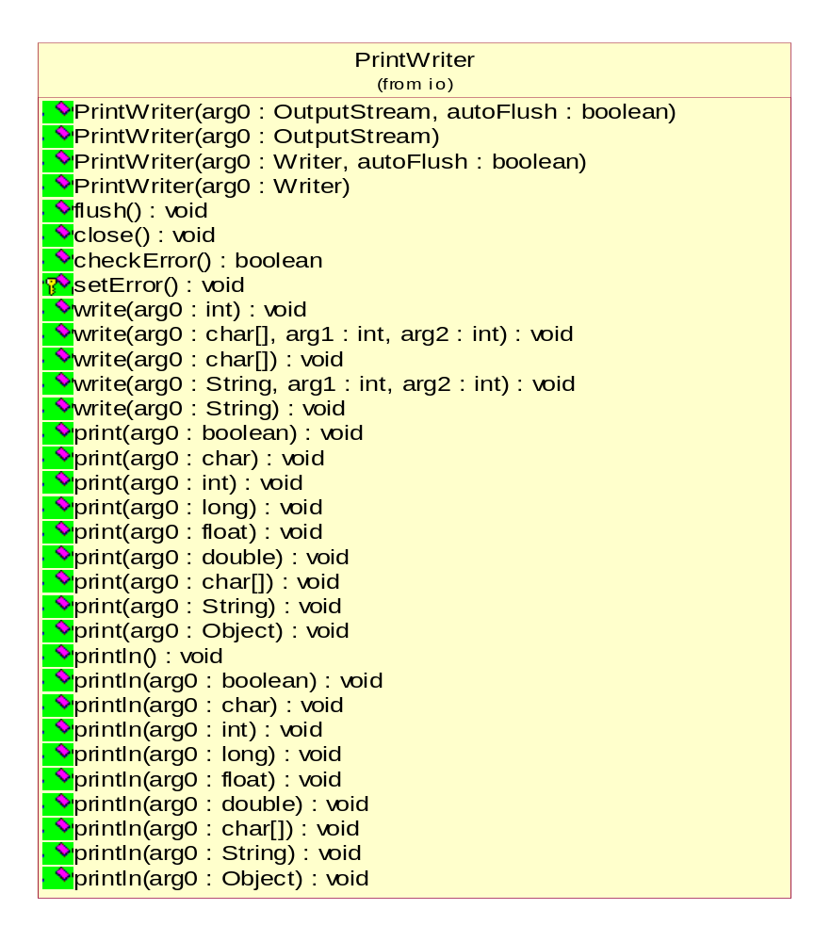

Slide 86
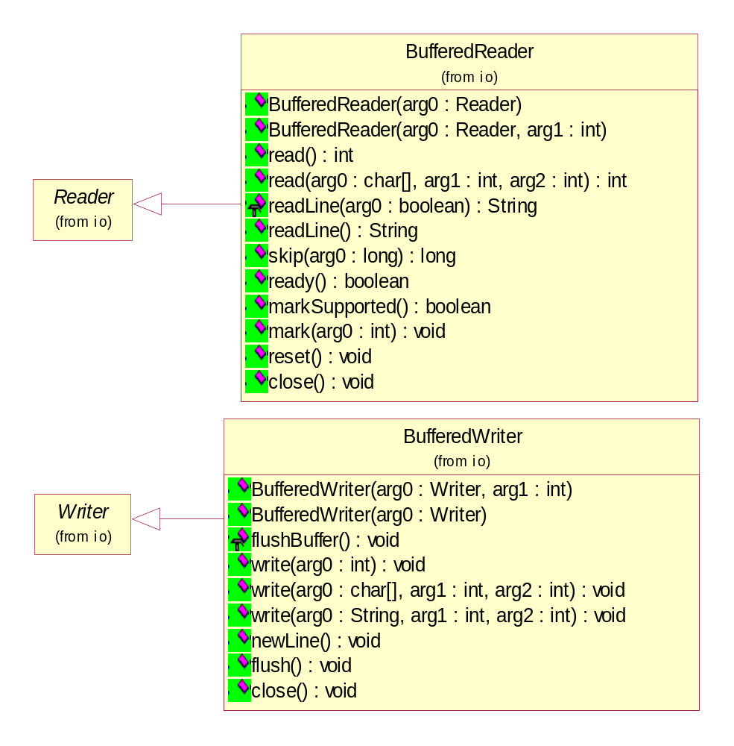
BufferedReader

Slide 87
BufferedWriter

Slide 88
java.io.OutputStreamWriter
public OutputStreamWriter(OutputStream out, String charsetName) throws UnsupportedEncodingException
  Create an OutputStreamWriter that uses the named charset.
Charset Description
US-ASCII Seven-bit ASCII, a.k.a. ISO646-US, a.k.a. the Basic Latin block of the Unicode character set
ISO-8859-1 ISO Latin Alphabet No. 1, a.k.a. ISO-LATIN-1
UTF-8 Eight-bit UCS Transformation Format
UTF-16BE Sixteen-bit UCS Transformation Format,
big-endian byte order
UTF-16LE Sixteen-bit UCS Transformation Format,
little-endian byte order
UTF-16 Sixteen-bit UCS Transformation Format, byte order identified by an optional byte-order mark

Slide 89
java.io.OutputStreamWriter
public OutputStreamWriter(OutputStream out)
  Create an OutputStreamWriter that uses the default character encoding.
public OutputStreamWriter(OutputStream out, CharsetEncoder enc)
  Create an OutputStreamWriter that uses the given charset encoder.
public String getEncoding()
  Return the name of the character encoding being used by this stream.
public void write(int c) throws IOException
  Write a single character.
public void write(char[] cbuf, int off, int len) throws IOException
  Write a portion of an array of characters.

Slide 90
java.io.OutputStreamWriter
public void write(String str, int off, int len) throws IOException
  Write a portion of a string.
public void flush() throws IOException
  Flush the stream.
public void close() throws IOException
  Close the stream.

Slide 91
OutputStreamWriter demo
import java.io.*;
public class OutputStreamToWriterDemo{
public static void main(String args[]){
try{
OutputStream output = new FileOutputStream("utf8.txt");
// Create an OutputStreamWriter
OutputStreamWriter writer = new OutputStreamWriter (output,"UTF-8");
// Write to file using a writer
writer.write ("Phạm Văn Tính");
// Flush and close the writer, to ensure it is written
writer.flush();
writer.close();
} catch (IOException ioe){
System.err.println ("I/O error : " + ioe);
}}}

Slide 92
java.io.InputStreamReader
An InputStreamReader is a bridge from byte streams to character streams: It reads bytes and decodes them into characters using a specified charset. The charset that it uses may be specified by name or may be given explicitly, or the platform's default charset may be accepted.
public InputStreamReader(InputStream in)
  Create an InputStreamReader that uses the default charset.
public InputStreamReader(InputStream in, String charsetName) throws UnsupportedEncodingException
  Create an InputStreamReader that uses the named charset.
public String getEncoding()
  Return the name of the character encoding being used by this stream.

Slide 93
java.io.InputStreamReader
public int read() throws IOException
  Read a single character.
public int read(char[] cbuf, int offset, int length) throws IOException
  Read characters into a portion of an array.
public boolean ready() throws IOException
  Tell whether this stream is ready to be read. An InputStreamReader is ready if its input buffer is not empty, or if bytes are available to be read from the underlying byte stream.
public void close() throws IOException

Slide 94
Charset Translation
public class InputStreamReaderDemo {
public static void main(String args[]){
try{
OutputStream output = new FileOutputStream("utf8_16.txt");
// Create an OutputStreamWriter
OutputStreamWriter writer = new OutputStreamWriter (output, "UTF-16");
InputStream input = new FileInputStream("utf8.txt");
InputStreamReader reader = new InputStreamReader(input, "UTF-8");
char[] buff = new char[100];
// Write to file using a writer
int rNumber = reader.read(buff);
System.out.println("Number of char: "+rNumber);
writer.write(buff,0,rNumber);
// Flush and close the writer, to ensure it is written
writer.flush(); writer.close();
reader.close();
} catch (IOException ioe){
System.err.println ("I/O error : " + ioe);
}}}

Slide 95
Complete example
Student List

Slide 96
Object Streams
Using a fixed-length record format is a good choice if you need to store data of the same type. However, objects that you create in an object-oriented program are rarely all of the same type.
If we want to save files that contain this kind of information, we must first save the type of each object and then the data that defines the current state of the object. When we read this information back from a file, we must:
  Read the object type;
  Create a blank object of that type;
  Fill it with the data that we stored in the file.
It is entirely possible (if very tedious) to do this by hand. However, Sun Microsystems developed a powerful mechanism called object serialization to read/write objects from/into the file.

Slide 97
Storing Objects of Variable Type
To save object data, you first need to open an ObjectOutputStream object:
ObjectOutputStream out = new ObjectOutputStream(
new FileOutputStream( “student.dat"));
Now, to save an object, you simply use the writeObject method of the ObjectOutputStream class as in the following fragment:
//create objects
Student hoa = new Employee(“Trần Thị Hoa",
1980, “CD02”);
Student vinh = new Employee(“Lương Thế Vinh",
1981, “DH03”);
//Storing objects into stream
out.writeObject(hoa);
out.writeObject(vinh);

Slide 98
Reading Objects back
First get an ObjectInputStream object
ObjectInputStream in = new ObjectInputStream(new FileInputStream("employee.dat"));
Then, retrieve the objects in the same order in which they were written, using the readObject method.
Student st1 = (Student)in.readObject();
Student st2 = (Student)in.readObject();
…………………………………………….
When reading back objects, you must carefully keep track of the number of objects that were saved, their order, and their types. Each call to readObject reads in another object of the type Object. You, therefore, will need to cast it to its correct type.

Slide 99
Serializable interface
you need to make to any class that you want to save and restore in an object stream. The class must implement the Serializable interface:
class Employee implements Serializable { . . . }
The Serializable interface has no methods, so you don't need to change your classes in any way.
To make a class serializable, you do not need to do anything else.
Writing an array is done with a single operation:
Student[] stList = new Student[3];
. . .
out.writeObject(stList);
Similarly, reading in the result is done with a single operation. However, we must apply a cast to the return value of the readObject method:
Student[] newStList = (Student[])in.readObject();

Slide 100
Student List using Object Streams
public class SerialStudent implements Serializable{
private String name;
private int age;
private String cl;
public SerialStudent(String n, int a, String c){
name = n;
age = a;
cl = c;
}
public String getName() { return name; }
public int getAge() { return age; }
public String getCl(){ return cl; }
public String toString() {
return getClass().getName() + "[Name=" + name
+ ",Age=" + age + ",Class=" + cl + "]";
}
public void exportData(PrintWriter out){
out.println(name + "|" + age + "|" + cl);
}}

Slide 101
Student List using Object Streams
public class SerialTest {
public static void main(String[] args) {
SerialStudent[] st = new SerialStudent[3];
st[0] = new SerialStudent("Phạm Thị Mỹ Hạnh", 20, "TC02");
st[1] = new SerialStudent("Trần Thị Hoa", 18, "CD02");
st[2] = new SerialStudent("Nguyễn Vãn Vệ", 19, "DH03");
try {
// save all students records to the file studentemployee.dat
ObjectOutputStream out = new ObjectOutputStream(new
FileOutputStream("SerialStudent.dat"));
out.writeObject(st);
out.close();
// retrieve all records into a new array
ObjectInputStream in = new ObjectInputStream(new
FileInputStream("SerialStudent.dat"));
try{
SerialStudent[] newSt = (SerialStudent[])in.readObject();
// print the newly read student records
for (int i = 0; i < newSt.length; i++) System.out.println(newSt[i]);
} catch (ClassNotFoundException e) {};
in.close();
……………………………………………..

Slide 102
java.io.ObjectOutputStream
ObjectOutputStream(OutputStream out)
creates an ObjectOutputStream so that you can write objects to the specified OutputStream.
void writeObject(Object obj)
writes the specified object to the ObjectOutputStream. This method saves the class of the object, the signature of the class, and the values of any non-static, non-transient field of the class and its superclasses.

Slide 103
java.io.ObjectInputStream
ObjectInputStream(InputStream is)
creates an ObjectInputStream to read back object information from the specified InputStream.
Object readObject()
reads an object from the ObjectInputStream. In particular, this reads back the class of the object, the signature of the class, and the values of the nontransient and nonstatic fields of the class and all of its superclasses. It does deserializing to allow multiple object references to be recovered.

Slide 104
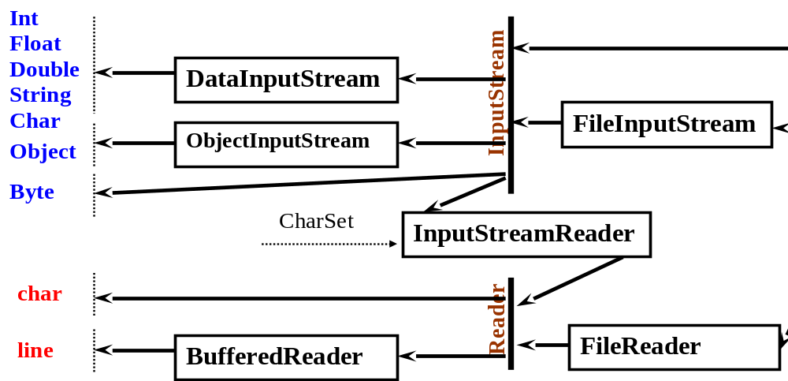
InputStream Summary

Slide 105
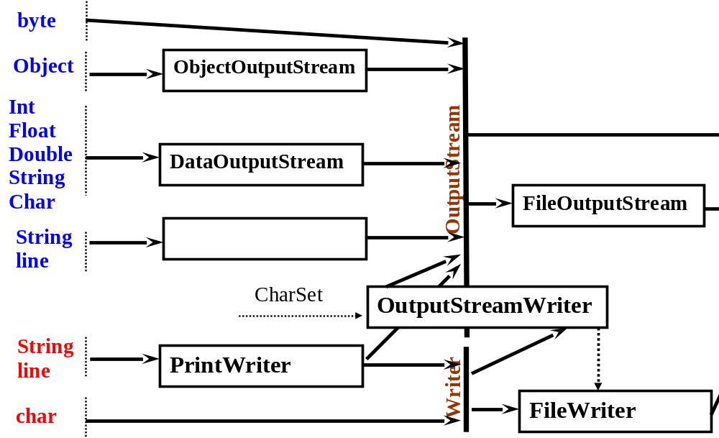
OutputStream Summary

